Slide 1
ES 200: Summer 2019-2020
Environmental Studies : Science and Engineering
Module C: Solid Waste Management
Prof. Tabish Nawaz (Module C)
(tnawaz@iitb.ac.in)
Environmental Science and Engineering Dept.,
IIT Bombay
* Instructor In-Charge
(vsethi@iitb.ac.in)

Slide 2
Module C
Solid Waste Management
Lecture-2 Topics
Characteristics of MSW
Physical
Chemical
Biochemical
Example Problems

Slide 3

Characteristics of MSW
Physical Characteristics
Moisture Content
Density
Compressibility
Field Capacity
Permeability
Size Distribution

Slide 4
Moisture Content
Moisture content of the solid waste is typically expressed as the weight of moisture per unit weight of wet material. It can also be expressed on a dry-basis.
For any given MSW sample, it can vary generally from 15 to 45% depending upon various factors.
An increase in moisture content increases the weight and thus the cost of transportation.
It is a critical determinant in the economic feasibility of waste treatment by incineration, because wet waste consumes energy for evaporation of water.
Moisture content is generally higher in low income countries because of the higher proportion of food waste.

Slide 5
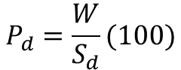
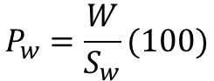
Moisture Content (P)
wet-basis (P_{w})
Wet-basis Moisture content(%)
Dry-basis Moisture content (%)
S_{w} is mass of wet-solids (as delivered); and S_{d} is the mass of dry solids
W is the mass of moisture = S_{w} - S_{d}
To obtain the dry mass (S_{d}), solids are oven-dried at 77ºC for 24 hr., to dehydrate the material completely and limit vaporization of volatile materials
P of Solid Waste
dry-basis (P_{d})
$$P_{w}=\frac{W}{S_{w}}(100)$$
$$P_{d}=\frac{W}{S_{d}}(100)$$

Slide 6
Moisture Content (P)
Typical data on moisture content of MSW components

Slide 7
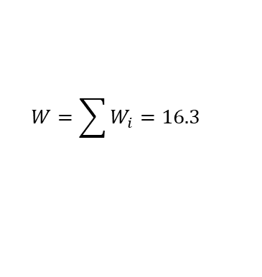
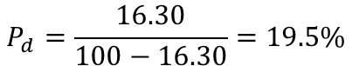
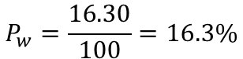
Moisture Content Example
Calculate the moisture content (wet and dry-basis) of the solid waste sample.
Component | Mass (%) | Moisture (%)
Newspaper | 15 | 6
Other papers | 24 | 6
Cardboard | 33 | 5
Glass | 4.2 | 0.5
Plastics | 0.49 | 2
Aluminum | 0.13 | 0.5
Ferrous | 1.18 | 0.5
Nonferrous | 0.35 | 0.5
Yard waste | 17.97 | 60
Food waste | 1.67 | 60
Dirt | 2.01 | 8
∑ | 100
Moisture (W_{i}) (kg)
0.9
1.44
1.65
0.021
0.0098
0.0007
0.006
0.002
10.78
1.0
0.16
16.30
$$W=\sum{W_{i}}=16.3$$
$$P_{w}=\frac{16.30}{100}=16.3\%$$
$$P_{d}=\frac{16.30}{100−16.30}=19.5\%$$

Slide 8
Density (ρ)
Density of waste, i.e., its mass per unit volume (kg/m³), is a critical factor for the design of all elements of the solid waste management systems like storage, transport and disposal.
For a known volume of the solid waste, its density gives us the idea about the requirement of the truck in tonnage.
The density varies significantly from source to the disposal site because of handling, change in moisture content, weather, densification due to vibration in the collection vehicle, decomposition, disturbance by scavengers etc.
Compressibility :
It is the degree of reduction of the volume of solid waste when subjected to pressure/mechanical loads.

Slide 9
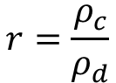
Density (ρ)
as-compacted density (ρ_{c})
Compaction ratio
There are two compaction ratios: final compaction ratio (r_{f}), such as in landfills; and initial compactor machine compaction ratio (r_{i}~2 - 4)
Landfill ρ_{c} can be as high as 900 kg/m³
Density of Solid Waste
as-discarded density (ρ_{d})
$$r=\frac{ρ_{c}}{ρ_{d}}$$

Slide 10
Density (ρ)
Typical densities of solid waste components and mixtures

Slide 11
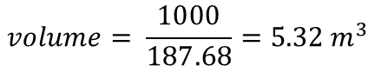
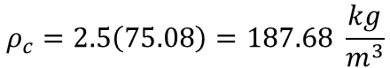
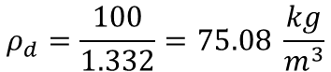
Density Example
Estimate the as-discarded density of the following solid waste. If the compaction ratio is 2.5, what size collection vehicle is needed per 1000 kg of waste?
Component | Mass (%) | Density (kg/m³)
Newspaper | 15 | 85
Other papers | 24 | 85
Cardboard | 33 | 50
Glass | 4.2 | 195
Plastics | 0.49 | 65
Aluminum | 0.13 | 160
Ferrous | 1.18 | 320
Nonferrous | 0.35 | 160
Yard waste | 17.97 | 105
Food waste | 1.67 | 290
Dirt | 2.01 | 480
∑ | 100
Volume (m³)
0.176
0.282
0.660
0.022
0.0075
0.0008
0.0037
0.0022
0.17
0.0058
0.0042
1.332
$$ρ_{d}=\frac{100}{1.332}=75.08 \frac{kg}{m^{3}}$$
$$ρ_{c}=2.5\left(75.08\right)=187.68 \frac{kg}{m^{3}}$$
$$volume= \frac{1000}{187.68}=5.32 m^{3}$$

Slide 12
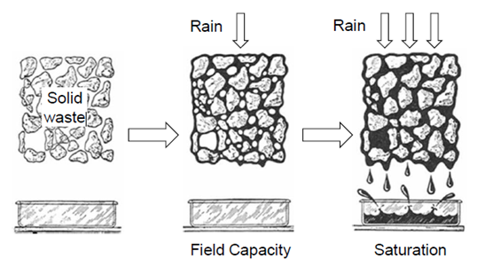
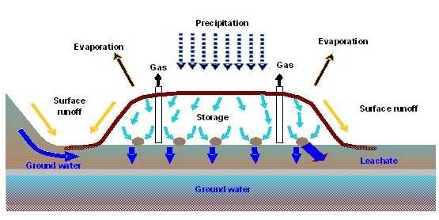
Field Capacity
Total amount of liquid which can be retained in a waste sample prior to downward percolation subject to gravitational pull.
Water in excess of field capacity will form leachates.
Field capacity varies with the degree of applied pressure and the state of decomposition of the wastes.
Typical values for un-compacted wastes from residential and commercial sources are in the range of 50 - 60%
http://mytutorial.srtcube.com/waste-management--basics/environment-science/826-389#7496

Slide 13
Permeability and Size Distribution
Rate of diffusion of liquid and gas through solid waste, of compacted wastes is an important physical property because it governs the movement of liquids (leachate) and gases (methane) in a landfill.
Permeability depends on: porosity, pore size distribution, surface area.
The porosity (volume of voids per total volume of material) of MSW varies typically from 0.40 to 0.67, depending on the compaction and composition of the waste.
Size distribution is important because of its significance in the design of mechanical separators and shredder and waste treatment process.

Slide 14
Characteristics of MSW
Chemical Characteristics
Proximate analysis
Ultimate analysis
Energy Content (Calorific value)
Synthetic organics

Slide 15
Proximate Analysis
Determine surrogate parameters
Important in evaluating the combustion properties.
The fractions of interest in proximate analysis are:
Moisture: Adds weight to the waste without increasing its heating value, and reduces the heat released from the fuel. (105ºC for 1 hr)
Volatile Matter: Portion of the waste that is converted to gases before and during combustion. (600 to 950ºC)
Fixed Carbon: Represents the carbon not burnt, remaining on the surface grates as charcoal.
A waste with a high proportion of fixed carbon requires a longer retention time on the furnace grates to achieve complete combustion.
Ash: Adds weight without generating any heat during combustion.

Slide 16
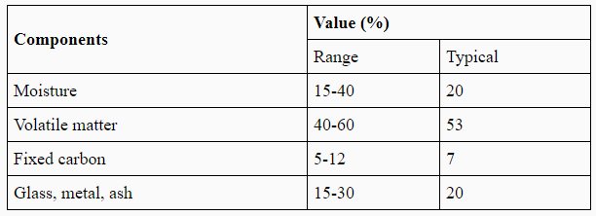
Proximate Analysis
Proximate Analysis of a MSW sample
% by mass

Slide 17
Ultimate Analysis
Determines the proportion of C, H, O, N and S
Done to perform mass balance calculations for a chemical or thermal process.
Ash fraction indicates the potential for harmful environmental effects, due to toxic metals such as cadmium, chromium, mercury, nickel, lead, tin and zinc. (Other non-toxic metals iron, magnesium may also be present)
Ultimate Analysis of a typical MSW
% by mass

Slide 18
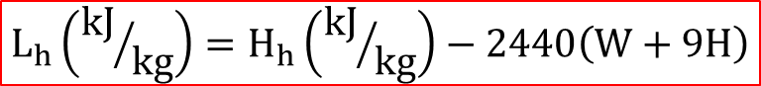
Energy Content (Calorific Value)
An evaluation of the potential of waste material for use as fuel requires a determination of its energy value (kJ/kg).
Higher heating value (H_{h}) is determined experimentally using the Bomb calorimeter test.
H_{h} includes the heat of vaporization of water; and L_{h} does not.
L_{h} represents net heat available in combustion reaction.
W is the kg of moisture; and H is the kg of dry waste that is hydrogen
Higher heat of combustion (H_{h})
Energy Content of Solid Waste (Heat of Combustion)
Lower heat of combustion (L_{h})
$$L_{h}\left({kJ}/{kg}\right)=H_{h}\left({kJ}/{kg}\right)−2440\left(W+9H\right)$$

Slide 19
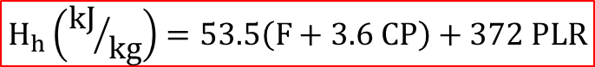
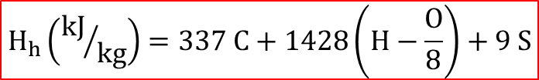
Energy Content (Calorific Value)
(1) Modified Dulong’s formula to obtain the higher heating value.
C: % mass-fraction of carbon; S: % mass-fraction of sulfur; H: % mass-fraction of total hydrogen; O: % mass-fraction of oxygen
(2) Approximate formula based on MSW fractions:
Where, F, CP, PLR are % mass-fractions of food waste, cardboard and paper; plastic, leather and rubber
$$H_{h}\left({kJ}/{kg}\right)=337 C+1428\left(H−\frac{O}{8}\right)+9 S$$
$$H_{h}\left({kJ}/{kg}\right)=53.5\left(F+3.6 CP\right)+372 PLR$$

Slide 20

Energy Content (Calorific Value)
Energy content can be converted to a dry basis, and ash-free dry-basis as per the following two equations:
$$E_{w} \left(dry basis\right)\left({kJ}/{kg}\right)=E_{w} \left(as discarded\right)\left({kJ}/{kg}\right)\frac{100}{100−\% moisture}$$
$$E_{w} \left(ash−free dry basis\right)\left({kJ}/{kg}\right)=E_{w} \left(as discarded\right)\left({kJ}/{kg}\right)\frac{100}{100−\% ash−\% moisture}$$

Slide 21
Synthetic Organics (Plastics)
They are highly resistant to biodegradation and, therefore, are of special concern in solid waste management.
Plastics have a high heating value, about 32,000 kJ/kg.
But, polyvinyl chloride (PVC), when burnt, produces dioxin and acid gas (H₂S + CO₂ + others).
Increases corrosion in the combustion system and is responsible for acid rain.
The thin plastic sheets and bags are not recycled as the cost of making it dirt and oil free makes the process uneconomical.

Slide 22
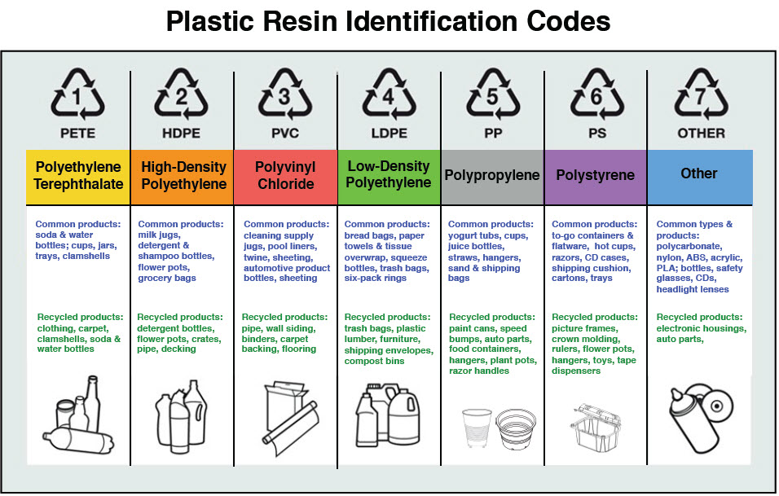
https://polychem-usa.com/plastic-coding-system/
Notes:
BPA is an industrial chemical that has been used to make certain plastics and resins for several decades. BPA is often found in polycarbonate plastics and epoxy resins.
PETE - generally considered to be a safe plastic and does not contain PPA, but on heating, it leaches out antimony into food and beverages which can cause vomiting, diarrhoea and stomach ulcers HDPE - generally considered to be a safe plastic but may leach estrogenic chemicals dangerous to foeti and juveniles PVC – flexible or rigid; contains a thphalate DEHP which can make male traits to become more feminine
LDPE – does not contain BPA but like most plastics, can form estrogenic chemicals
PP – high heat tolerance; does not leach many chemicals PS/Styrofoam – can leach styrene (suspected carcinogen) esp. in the presence of heat – hot coffee in styrofoam container = very unwise choice

Slide 23
Characteristics of MSW
Biochemical Characteristics
Lipids
Carbohydrates
Proteins
Natural fiber

Slide 24
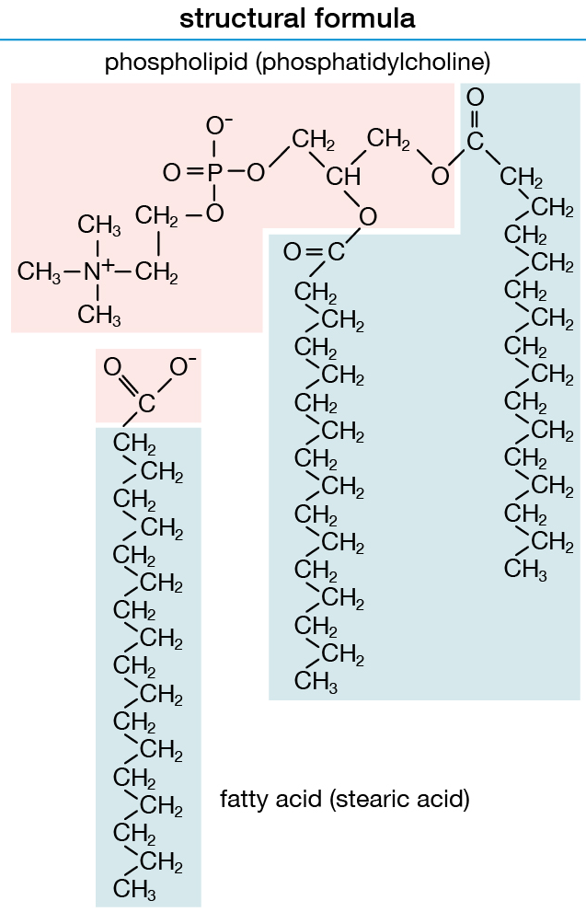
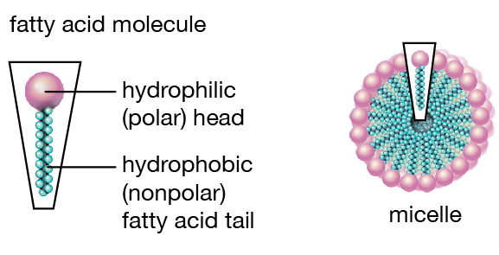
Biochemical Characteristics – Lipids
Lipids (fats, oils and grease) are made up of fatty acid monomers
High calorific values (38000 kJ/kg).
Lipids become liquid at temperatures slightly above ambient.
They are biodegradable but due to low solubility, the rate of biodegradation is relatively slow.
https://www.britannica.com/science/lipid#/media/1/342808/92231

Slide 25
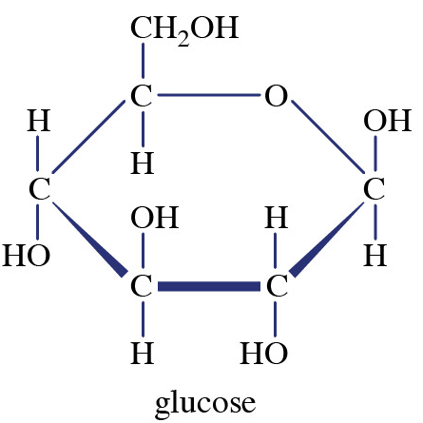
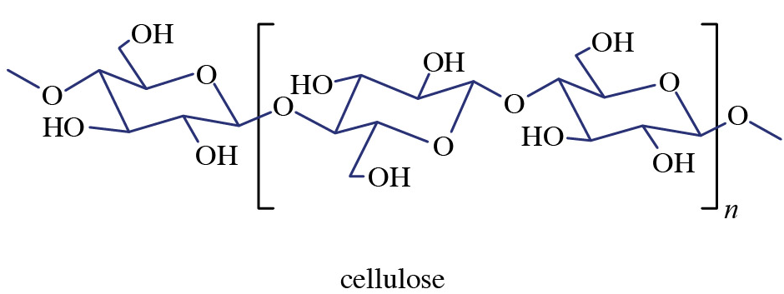
Biochemical Characteristics – Carbohydrates
Carbohydrates are found primarily in food and yard waste. (~16000 kJ/kg)
They include sugars and polymers of sugars such as starch and cellulose and have the general formula C_{x}(H₂O)_{y}.
Carbohydrates are readily biodegraded to products such as carbon dioxide, water and methane.
Decomposing carbohydrates are particularly attractive for flies and rats and for this reason should not be left exposed for longer periods.
https://www.britannica.com/science/carbohydrate#/media/1/94687/159267
Notes:
Cellulose – principal structural component of plants; complex polysaccharide comprising of several glucose units linked together; most common polysaccharide Starch – in plants; complex glucose polysaccharide
Glycogen – in animals; complex glucose polysaccharide

Slide 26
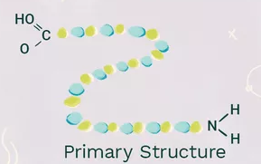
Biochemical Characteristics – Proteins
Proteins are compounds containing carbon, hydrogen, oxygen and nitrogen and consist of an organic acid with a substituted amine group (NH₂).
They are found mainly in food and garden wastes and comprise 5-10% of the dry solids in solid waste.
Proteins decompose to form amino acids but partial decomposition can result in the production of amines, which have intensely unpleasant odors.
Alpha carbon bonded to:
Hydrogen atom (H)
Carboxyl group (-COOH)
Amino group (-NH2)
Variable (R) group
https://www.thoughtco.com/protein-structure-373563

Slide 27
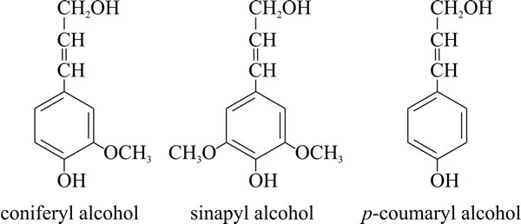
Biochemical Characteristics – Natural Fibres
Includes the natural compounds, cellulose and lignin, both of which are resistant to biodegradation.
They are found in paper and paper products and in food and yard waste.
Cellulose is a larger polymer of glucose
Lignin is composed of a group of monomers of which methoxylated benzene is the primary member.
Since they are highly combustible, solid waste having a high proportion of paper and wood products, are suitable for incineration.
The calorific values of paper products are ~ 15000 kJ/kg and demolition softwood ~ 16000 kJ/kg
Chemical structures of the phenylpropanoid alcohols used to construct the lignin polymer.
Notes:
Natural fibre – agglomeration of cells where diameter is negligible with respect to length

Slide 28
Summary Questions
Estimate the energy content of a solid waste sample with the composition given below. Also, calculate the energy content on a dry basis and on an ash-free dry basis?
Component | Percent by mass
Food waste | 15
Paper | 45
Cardboard | 10
Plastics | 10
Garden trimmings | 10
Wood | 5
Tin cans | 5
Submission due by 23rd September 2020

